Slide 1



Noida Institute of Engineering and Technology, Greater Noida
TRANSACTION PROCESSING AND RECOVERY CONCEPT
Unit: 4
DBMS
Dr Kumud Saxena
HOD
(AI-I0T-CS)
Course Details (B Tech 5th Sem)

Slide 2
Brief Introduction of Faculty member

Slide 3
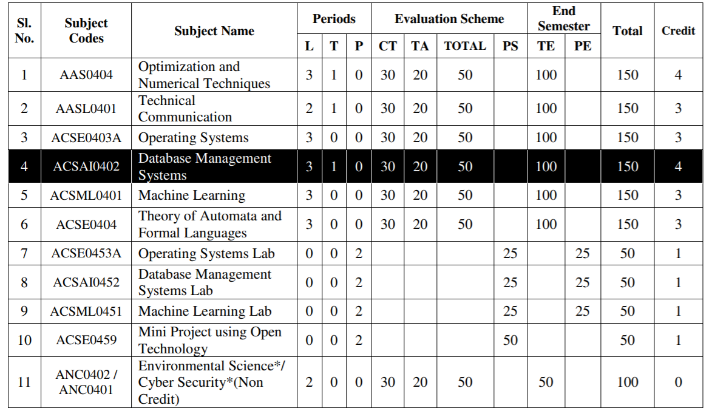
Evaluation Scheme

Slide 4
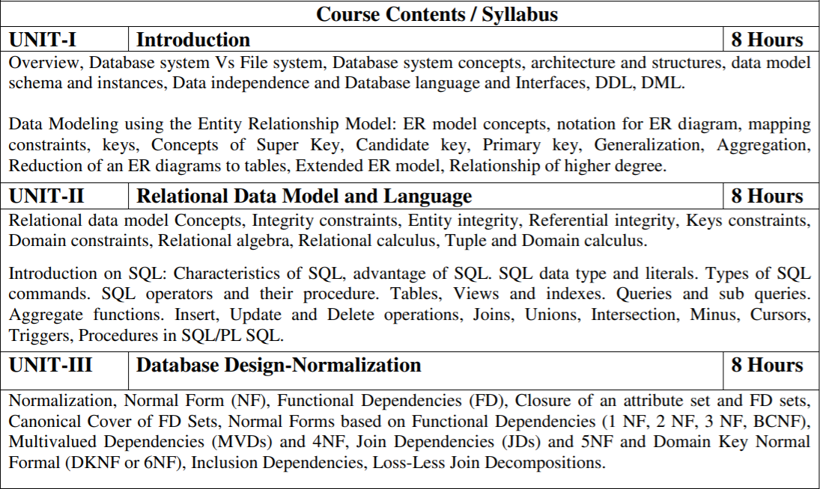
Subject Syllabus

Slide 5
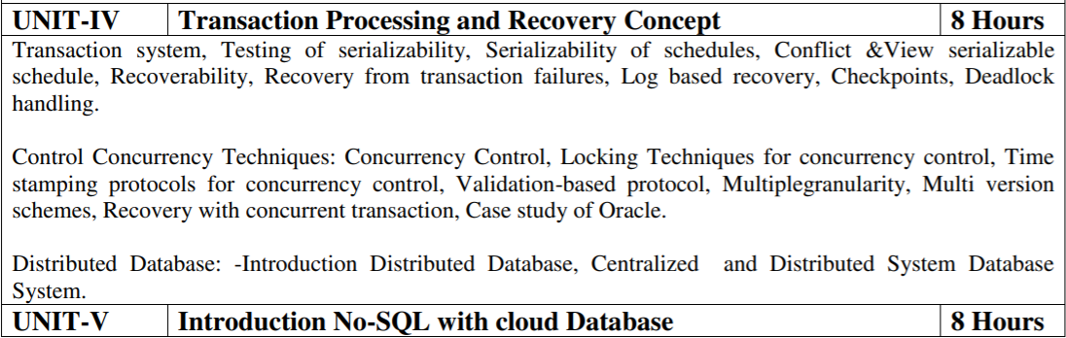
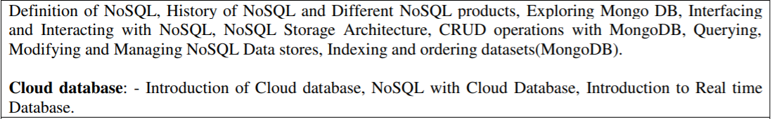
Subject Syllabus

Slide 6
Branch wise Applications
1. AI - Apache Cassandra is an open-source and highly scalable NoSQL database management system that is designed to manage massive amounts of data in a faster manner. This popular database is being used by GitHub, Netflix, Instagram, Reddit, among others.
2. IoT - IoT devices' primary purpose is often to collect and/or generate data and share it for some higher purpose such as analytics, machine learning and artificial intelligence. Consequently, IoT DBMSs need to manage not just data at rest, but also data in transit.
3. CS – There are various application of dbms in different fields like Railway Reservation System, Library Management System, Banking, Universities and colleges, Credit card transactions etc

Slide 7
Course Objective
List and explain the fundamental concepts of a relational database system
Knowledge of DBMS, both in terms of use and implementation/design.
Experience with SQL and Manipulate a database using SQL
Increased proficiency with the programming language C++.
Experience working as part of team v Experience with analysis and design of (DB) software
Assess the quality and ease of use of data modeling and diagramming tools
Utilize a wide range of features available in a DBMS package.

Slide 8
Course Outcome
S. NO. | Course Outcomes | Blooms’ Taxonomy
KCS501.1 | Apply knowledge of database for real life applications. | K3
KCS501.2 | Apply query processing techniques to automate the real time problems of databases. | K3, K4
KCS501.3 | Identify and solve the redundancy problem in database tables using normalization | K2, K3
KCS501.4 | Understand the concepts of transactions, their processing so they will familiar with broad range of database management issues including data integrity, security and recovery. | K2, K4
KCS501.5 | Design, develop and implement a small database project using database tools. | K3, K6

Slide 9
Program Outcomes

Slide 10
COs and POs Mapping
 | PO1 | PO2 | PO3 | PO4 | PO5 | PO6 | PO7 | PO8 | PO9 | PO10 | PO11 | PO12
KCS501.1 | 2 | 2 | 3 | 3 | 3 | 2 | 3 | 2 | 2 | 2 | 2 | 3
KCS501.2 | 3 | 3 | 3 | 2 | 2 | 2 | 2 | 2 | 2 | 2 | 2 | 3
KCS501.3 | 2 | 3 | 3 | 3 | 3 | 2 | 2 | 2 | 2 | 2 | 2 | 2
KCS501.4 | 2 | 3 | 2 | 2 | 2 | 2 | 2 | 2 | 2 | 3 | 2 | 2
KCS501.5 | 2 | 3 | 2 | 2 | 2 | 3 | 2 | 2 | 3 | 2 | 2 | 2
AVG | 2.20 | 2.80 | 2.60 | 2.40 | 2.40 | 2.20 | 2.20 | 2.00 | 2.20 | 2.20 | 2.00 | 2.40

Slide 11
Program Specific Outcomes (PSOs)

Slide 12
COs and PSOs Mapping
 | Program Specific Outcomes
 | PSO1 | PSO2 | PSO3 | PSO4
KCS-501.1 | 3 | 1 | 3 | 1
KCS-501.2 | 3 | 1 | 3 | 1
KCS-501.3 | 3 | 1 | 3 | 1
KCS-501.4 | 3 | 1 | 3 | 1
KCS-501.5 | 3 | 1 | 3 | 1
AVG | 3.00 | 1.00 | 3.00 | 1.00

Slide 13
Program Educational Objectives (PEOs)

Slide 14
Result Analysis

Slide 15
End Semester Question Paper Templates

Slide 16
Prerequisite and Recap
There is No prerequisite for learning DBMS from scratch.
Having knowledge of basic mathematics like - SUM, DIFFERENCE, AVERAGE, MEAN, MEDIAN, MODE, etc will definitely be a plus point.
Having knowledge on Set Theory will help.
The proper understanding of data structures (B and B+ trees) will help you to understand the DBMS quickly.

Slide 17
Brief Introduction about the Subject
A database management system (DBMS) refers to the technology for creating and managing databases. DBMS is a software tool to organize (create, retrieve, update, and manage) data in a database.
The main aim of a DBMS is to supply a way to store up and retrieve database information that is both convenient and efficient. By data, we mean known facts that can be recorded and that have embedded meaning.
Usually, people use software such as DBASE IV or V, Microsoft ACCESS, or EXCEL to store data in the form of a database. A datum is a unit of data. Meaningful data combined to form information. Hence, information is interpreted data - data provided with semantics. MS. ACCESS is one of the most common examples of database management software.

Slide 18
Content - Unit 4
Transaction Processing Concept: Transaction system, Testing of serializability, serializability of schedules, conflict & view serializable schedule, recoverability, Recovery from transaction failures, log based recovery, checkpoints, deadlock handling.
Distributed Database: distributed data storage, concurrency control, directory system.

Slide 19
Unit Objective
Concurrency Control in Database Management System is a procedure of managing simultaneous operations without conflicting with each other. It ensures that Database transactions are performed concurrently and accurately to produce correct results without violating data integrity of the respective Database.
Concurrency control is the activity of coordinating the simultaneous execution of transactions in a multiprocessing or multi-user database management system. The objective of concurrency control is to ensure the serializability of transactions in a multi-user database management system.

Slide 20
Topic – Transaction and its Property Objective
The DBMS is used to schedule the access of data concurrently.
It means that the user can access multiple data from the database without being interfered with each other.
Transactions are used to manage concurrency.
It is also used to satisfy ACID properties.

Slide 21
Transaction
Goal :- Understand the basic properties of a transaction and learn the concepts underlying transaction processing as well as the concurrent executions of transactions.
A transaction is a unit of a program execution that accesses and possibly modifies various data objects (tuples, relations). Or
Collections of operations that form a single logical unit of work are called transactions.
A database system must ensure proper execution of transactions despite failures — either the entire transaction executes, or none of it does.
Transaction Operations are :- Read (),Write ();

Slide 22
Example
E.g., transaction to transfer $50 from account A to account B:
1. read(A)
2. A := A – 50
3. write(A)
4. read(B)
5. B := B + 50
6. write(B)
Two main issues to deal with:
Failures of various kinds, such as hardware failures and system crashes
Concurrent execution of multiple transactions

Slide 23
Required Properties of a Transaction
To preserve the integrity of data the database system must ensure ACID Properties.
ACID Properties are :-
Atomicity
Durability
Consistency
Isolation

Slide 24
ACID Properties
Atomicity. Either all operations of the transaction are properly reflected in the database or none are.
Consistency. Execution of a transaction in isolation preserves the consistency of the database.
Isolation. Although multiple transactions may execute concurrently, each transaction must be unaware of other concurrently executing transactions. Intermediate transaction results must be hidden from other concurrently executed transactions.
That is, for every pair of transactions T_{i} and T_{j}, it appears to T_{i} that either T_{j}, finished execution before T_{i} started, or T_{j} started execution after T_{i} finished.
Durability. After a transaction completes successfully, the changes it has made to the database persist, even if there are system failures.

Slide 25
Example of Fund Transfer
Transaction to transfer $50 from account A to account B:
1. read(A)
2. A := A – 50
3. write(A)
4. read(B)
5. B := B + 50
6. write(B)
Atomicity requirement
if the transaction fails after step 3 and before step 6, money will be “lost” leading to an inconsistent database state
Failure could be due to software or hardware
the system should ensure that updates of a partially executed transaction are not reflected in the database
Durability requirement — once the user has been notified that the transaction has completed (i.e., the transfer of the $50 has taken place), the updates to the database by the transaction must persist even if there are software or hardware failures.

Slide 26
Example of Fund Transfer
Transaction to transfer $50 from account A to account B:
1. read(A)
2. A := A – 50
3. write(A)
4. read(B)
5. B := B + 50
6. write(B)
Consistency requirement in above example:
the sum of A and B is unchanged by the execution of the transaction
In general, consistency requirements include
Explicitly specified integrity constraints such as primary keys and foreign keys
Implicit integrity constraints
e.g. sum of balances of all accounts, minus sum of loan amounts must equal value of cash-in-hand
A transaction must see a consistent database.
During transaction execution the database may be temporarily inconsistent.
When the transaction completes successfully the database must be consistent
Erroneous transaction logic can lead to inconsistency

Slide 27
Example of Fund Transfer
Isolation requirement — if between steps 3 and 6, another transaction T2 is allowed to access the partially updated database, it will see an inconsistent database (the sum A + B will be less than it should be). T1 T2
1. read(A)
2. A := A – 50
3. write(A) read(A), read(B), print(A+B)
4. read(B)
5. B := B + 50
6. write(B)
Isolation can be ensured trivially by running transactions serially
that is, one after the other.
However, executing multiple transactions concurrently has significant benefits, as we will see later.

Slide 28
Transaction State
Active – the initial state; the transaction stays in this state while it is executing
Partially committed – after the final statement has been executed.
Failed -- after the discovery that normal execution can no longer proceed.
Aborted – after the transaction has been rolled back and the database restored to its state prior to the start of the transaction. Two options after it has been aborted:
Restart the transaction
can be done only if no internal logical error
Kill the transaction
Committed – after successful completion.

Slide 29
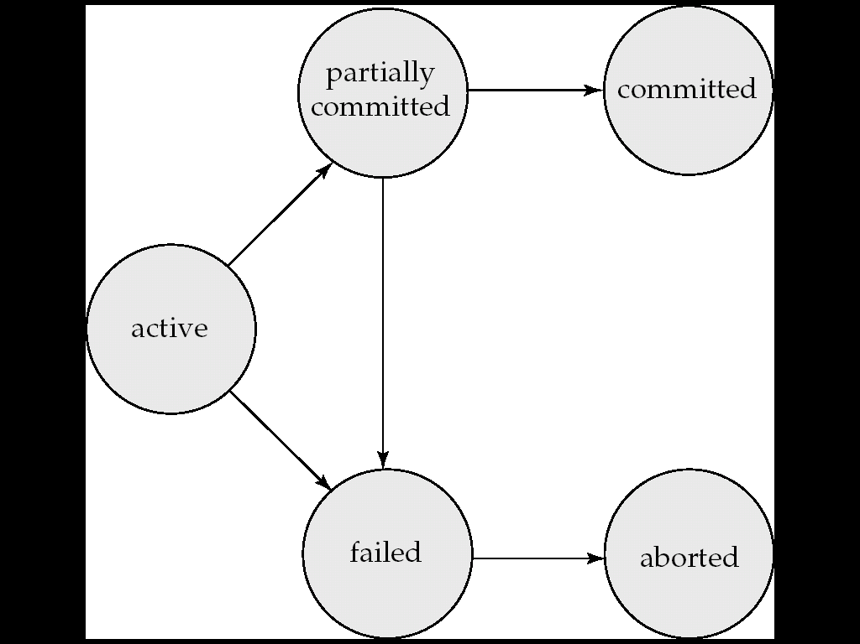
Transaction State Diagram

Slide 30
Concurrent Executions
Multiple transactions are allowed to run concurrently in the system. Advantages are:-
Increased processor and disk utilization, leading to better transaction throughput
E.g. one transaction can be using the CPU while another is reading from or writing to the disk.
Reduced average response time for transactions: short transactions need not wait behind long ones.

Slide 31
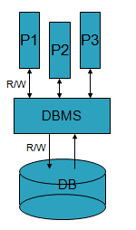
Concurrent Executions
Challenges:-
Concurrency Control: How do the DBMSs handle concurrent transactions?
Crash Recovery: How do the DBMSs handle partial transactions because of machine crashes or users abort the transactions ?

Slide 32
Short Quiz
1. A transaction is delimited by statements (or function calls) of the form
a) Begin transaction and end transaction b) Start transaction and stop transaction c) Get transaction and post transaction d) Read transaction and write transaction
2. Identify the characteristics of transactions a) Atomicity b) Durability c) Isolation d) All of the mentioned

Slide 33
Topic – Schedule Objective
When multiple transactions are running concurrently then there needs to be a sequence in which the operations are performed because at a time only one operation can be performed on the database. This sequence of operations is known as Schedule.
Note that the main objective of serializability is to find non-serial schedules that allow transactions to execute concurrently without interference and produce a database state that could be produced by a serial execution.

Slide 34
Schedule (CO4)
We know that transactions are set of instructions and these instructions perform operations on database.
When multiple transactions are running concurrently then there needs to be a sequence in which the operations are performed because at a time only one operation can be performed on the database. This sequence of operations is known as Schedule.
Schedule – A sequences of instructions that specify the chronological order in which instructions of concurrent transactions are executed.

Slide 35
Continue…..
A schedule is a collection of many transactions which is implemented as a unit.
Depending upon how these transactions are arranged in within a schedule, a schedule can be of two types:-
Serial: The transactions are executed one after another, in a non-preemptive manner.
Concurrent: The transactions are executed in a preemptive, time shared method.

Slide 36
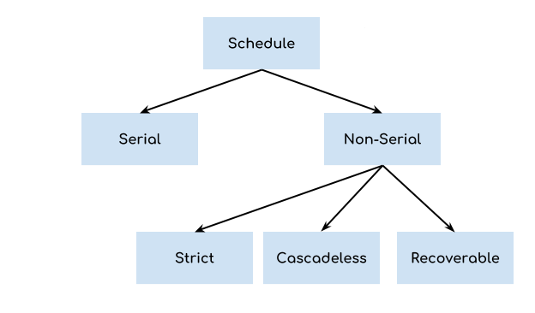
Types of Schedules in DBMS

Slide 37
Types of Schedules in DBMS
1. Serial Schedule:- In Serial schedule, a transaction is executed completely before starting the execution of another transaction. In other words, you can say that in serial schedule, a transaction does not start execution until the currently running transaction finished execution. This type of execution of transaction is also known as non-interleaved execution.
2. Non Serial Schedule :- In Non Serial schedule, a transaction is executed completely in context switching mode.(Concurrent Execution).
Note:- The transactions are executed in a non-serial manner, keeping the end result correct and same as the serial schedule.

Slide 38
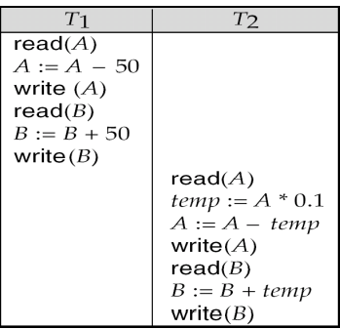
Schedule 1: serial schedule
Let T₁ transfer 50 from A to B, and T₂ transfer 10% of the balance from A to B.
A serial schedule in which T₁ is followed by T₂ :-
In this example, the transaction T2 does not start execution until the transaction T1 is finished.

Slide 39
Serial schedule
Schedule 1: serial schedule :-
T2 is a new transaction which deposits to account B 10% of the amount in account A. If we prepare a serial schedule, then either T1 will completely finish before T2 can begin, or T2 will completely finish before T1 can begin.

Slide 40
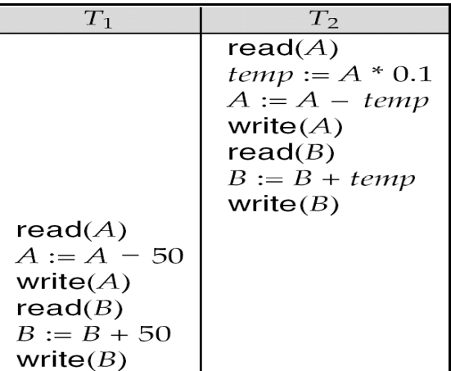
Schedule 2: serial schedule
A serial schedule where T₂ is followed by T₁

Slide 41
Schedule 3: non serial schedule
However, if we want to create a concurrent schedule, then some Context Switching need to be made, so that some portion of T1 will be executed, then some portion of T2 will be executed and so on.
Let T₁ and T₂ be the transactions defined previously. The following schedule is not a serial schedule, but it is equivalent to Schedule 1.

Slide 42
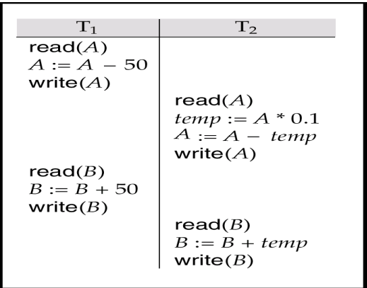
Schedule 3: non serial schedule
In Schedules 1, 2 and 3, the sum A + B is preserved.

Slide 43
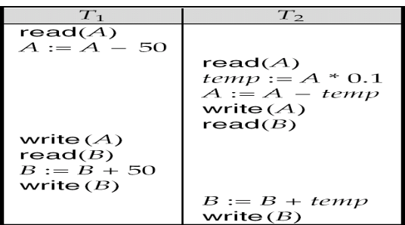
Schedule 4: non serial schedule
The following concurrent schedule does not preserve the value of (A + B ).

Slide 44
Short Quiz
I and J are _________ if they are operations by different transactions on the same data item, and at least one of them is a write operation. a) Conflicting b) Overwriting c) Isolated d) Durable
A schedule is __________ if it is conflict equivalent to a serial schedule. a) Conflict serializable b) Conflicting c) Non serializable d) None of the mentioned

Slide 45
Topic – Serializability Objective
The main objective of serializability is to find non-serial schedules that allow transactions to execute concurrently without interference and produce a database state that could be produced by a serial execution.
Serializability helps preserve the consistency and concurrency of a database. There are 2 methods widely used to check serializability i.e. Conflict equivalent and View equivalent.

Slide 46
Serializability
In the above example 4, we detected the error simple by examining the schedule and applying common sense .But there must be some well formed rules regarding how to arrange instructions of the transactions to create error free concurrent schedules.
When multiple transactions are running concurrently then there is a possibility that the database may be left in an inconsistent state.
Serializability is a concept that helps us to check which schedules are serializable. A serializable schedule is the one that always leaves the database in consistent state.
A serial schedule is always a serializable schedule because in serial schedule, a transaction only starts when the other transaction finished execution.
However a non-serial schedule needs to be checked for Serializability.

Slide 47
Serializability
A non-serial schedule of n number of transactions is said to be serializable schedule, if it is equivalent to the serial schedule of those n transactions.
A serial schedule doesn’t allow concurrency, only one transaction executes at a time and the other starts when the already running transaction finished.
Basic Assumption – Each transaction preserves database consistency.
Thus serial execution of a set of transactions preserves database consistency.
Note :- A schedule is serializable if it is equivalent to a serial schedule.
There are Two type of Serializability : -
conflict serializability: A non serial schedule is converted into serial schedule by swapping non conflicting operations then it is known as conflict serializable schedule.
view serializability:- If a schedule is view equivalent to its serial schedule then the given schedule is said to be View Serializable.

Slide 48
Conflict Serializability
A schedule is called conflict serializable if after swapping of non-conflicting operations, it can transform into a serial schedule.
The schedule will be a conflict serializable if it is conflict equivalent to a serial schedule.
Two instructions of two different transactions may want to access the same data item in order to perform a read/write operation. Conflict Serializability deals with detecting whether the instructions are conflicting in any way, and specifying the order in which these two instructions will be executed in case there is any conflict.
A conflict arises if at least one (or both) of the instructions is a write operation.
TI R(x)= T2R(x)// non Conflict
TI R(x)= T2W(x)//Conflict
TI W(x)= T1R(x)//Conflict
TI W(x)= T2W(x)//Conflict

Slide 49
Rules for Conflict Serializability
The following rules are important in Conflict Serializability:
If two instructions of the two concurrent transactions are both for read operation, then they are not in conflict, and can be allowed to take place in any order.
2. If one of the instructions wants to perform a read operation and the other instruction wants to perform a write operation, then they are in conflict, hence their ordering is important. If the read instruction is performed first, then it reads the old value of the data item and after the reading is over, the new value of the data item is written. It the write instruction is performed first, then updates the data item with the new value and the read instruction reads the newly updated value.

Slide 50
Conflict Serializability
3. If both the transactions are for write operation, then they are in conflict but can be allowed to take place in any order, because the transaction do not read the value updated by each other. However, the value that persists in the data item after the schedule is over is the one written by the instruction that performed the last write.
Finally we can say:-
Two instruction/operation are said to be in conflict Operation, if they satisfy all the following three conditions:-
Two operation are set of conflicting when they should belong to different transactions.
Both the instruction are working on same data item.
At least one of the instruction is a write instruction.

Slide 51
Conflict Equivalent Schedules
Two schedules are said to be conflict Equivalent if one schedule can be converted into other schedule after swapping non-conflicting operations.
Two schedules are said to be conflict equivalent if and only if:
They contain the same set of the transaction.
If each pair of conflict operations are ordered in the same way.

Slide 52
1. Conflict Serializability
Methods for conflict Serializability are :-
Swapping:- A schedule is called conflict serializable if we can convert it into a serial schedule after swapping its non-conflicting operations.
2. precedence Graph.

Slide 53
Conflicting and non conflicting operations
Instructions l_{i} and l_{j} of transactions T_{i} and T_{j} respectively, conflict if and only if there exists some item Q accessed by both l_{i} and l_{j}, and at least one of these instructions wrote Q.
1. l_{i} = read(Q), l_{j} = read(Q). l_{i} and l_{j} don’t conflict. 2. l_{i} = read(Q), l_{j} = write(Q). They conflict. 3. l_{i} = write(Q), l_{j} = read(Q). They conflict 4. l_{i} = write(Q), l_{j} = write(Q). They conflict
It seem that , a conflict between l_{i} and l_{j} forces a (logical) temporal order between them.
If l_{i} and l_{j} are consecutive in a schedule and they do not conflict, their results would remain the same even if they had been interchanged in the schedule.

Slide 54
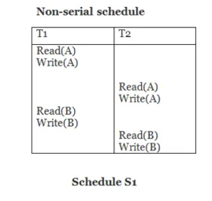
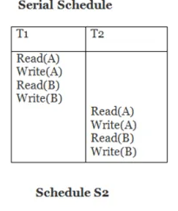
1. Conflict Serializability (Cont.) by Swapping
Example :-
Schedule S1 can be transformed into Schedule S2, a serial schedule where T₂ follows T₁, by series of swaps of non-conflicting instructions.
Therefore Schedule S1 is conflict serializable.

Slide 55
Continue
In Non Serial Schedule S1
Two instruction are set of conflicting when they should belong to different transactions. YES
Both the operations are working on same data item. NO
(Such case instruction are not conflict swap it)
3 . At least one of the operation is a write instruction.
(Don’t need to check because 2nd condition is disqualified for conflict operation)
So Non Serial schedule (schedule S1) is Conflict Serializable and also a serial schedule if this is a serial schedule maintain the consistency of database.

Slide 56
B. Precedence Graph
A precedence graph, also known as serialization graph or conflict graph, is used for testing Conflict Serializability of a schedule in the condition that forms the setting of concurrency control in databases.
In a schedule of a precedence graph, The total number of transactions will be similar to the total number of nodes.
Nodes: In the graph, for each transaction Tp the graph contains a single node.
Edges: An edge is regulated connectivity between a set of two distinct transactions Tq and Tr and it shows in the format Tq –>Tr, where Tq is the beginning of the edge and Tr is the ending.

Slide 57
The Algorithm for testing Conflict Serializability of a schedule
Create a node T, for each transaction participating in schedule S in the precedence graph.
For every condition in schedule S create an edge Tp → Tq in the precedence graph if a Transaction Tq implements a read_item (Z) after Tp implements a write_item (Z). It's a Read-Write conflict.
For every condition in schedule S create an edge Tp → Tq in the precedence graph if a Transaction Tq implements a write_item (Z) after Ti implements a read_item (Z). It's a Write-Read conflict.
For every condition in schedule S create an edge Tp → Tq in the precedence graph If a Transaction Tq implements a write_item (Z) after Tp implements a write_item (Z). It's a Write-Write conflict.
If and only if there is no cycle in the precedence graph, then the schedule S is Serializable.

Slide 58
2. View Serializability
This is another type of serializability that can be derived by creating another schedule out of an existing schedule, involving the same set of transactions.
It is a type of serializability that can be used to check whether the given schedule is view serializable or not.
A schedule called as a view serializable if it is view equivalent to a serial schedule.

Slide 59
Why we need View Serializability?
We know that a serial schedule never leaves the database in inconsistent state because there are no concurrent transactions execution.
However a non-serial schedule can leave the database in inconsistent state because there are multiple transactions running concurrently. By checking that a given non-serial schedule is view serializable, we make sure that it is a consistent schedule.
You may be wondering instead of checking that a non-serial schedule is serializable or not, can’t we have serial schedule all the time?
The answer is no, because concurrent execution of transactions fully utilize the system resources and are considerably faster compared to serial schedules.

Slide 60
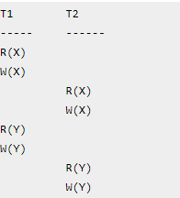
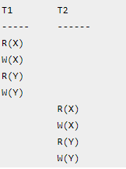
View Equivalent
Example:-
Serial Schedule of the above given schedule:
As we know that in Serial schedule a transaction only starts when the current running transaction is finished.
If we can prove that the given schedule is View Equivalent to its serial schedule then the given schedule is called view Serializable.

Slide 61
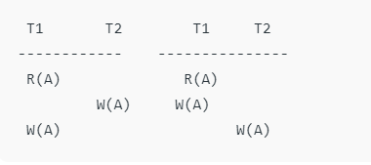
Condition of schedules to View-equivalent
Condition of schedules to View-equivalent
Consider two schedules S1 and S2 each consisting of two transactions T1 and T2.
Schedules S1 and S2 are called view equivalent if the following all three conditions hold true for them-
Note:- Let us consider that the transactions T1 and T2 are being serialized to create two different schedules S1 and S2 which we want to be View Equivalent and both T1 and T2 wants to access the same data item.
1)Initial Read For each data item A, if transaction T_{i} reads A from the database initially in schedule S1, then in schedule S2 also, T_{i} must perform the initial read of A from the database.(“Initial readers must be same for all the data items”.)
Transaction T1 is reading A from database.

Slide 62
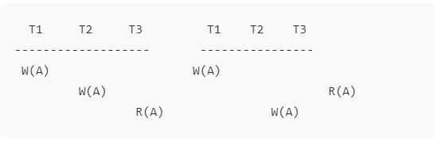
Cont…. (CO4)
2)Updated Read or intermediate read
If transaction T_{i} reads a data item that has been updated by the transaction T_{j} in schedule S1, then in schedule S2 also, transaction T_{i} must read the same data item that has been updated by the transaction T_{j.}
₍“Write-read sequence must be same.”.₎
Above two schedule are not view-equivalent as in S1 :T3 is reading A updated by T2, in S2 T3 is reading A updated by T1.

Slide 63
Conti……..
3)Final Write operation
For each data item A, if A has been updated at last by transaction T_{i} in schedule S1, then in schedule S2 also, A must be updated at last by transaction T_{i}.
“Final writers must be same for all the data items”.
Above two schedules are not view-equivalent as Final write operation in S1 is done by T1 while in S2 done by T2.

Slide 64
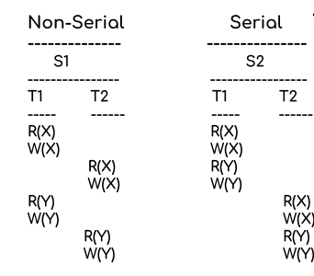
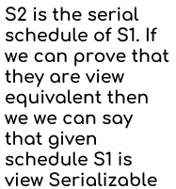
Example
Lets take an example.
Lets check the three conditions of view serializability.
1. Initial Read
In schedule S1, transaction T1 first reads the data item X. In S2 also transaction T1 first reads the data item X.
Lets check for Y. In schedule S1, transaction T1 first reads the data item Y. In S2 also the first read operation on Y is performed by T1.
We checked for both data items X & Y and the initial read condition is satisfied in S1 & S2.

Slide 65
Conti….
2. Update Read
In S1, transaction T2 reads the value of X, written by T1. In S2, the same transaction T2 reads the X after it is written by T1.
In S1, transaction T2 reads the value of Y, written by T1. In S2, the same transaction T2 reads the value of Y after it is updated by T1.
The update read condition is also satisfied for both the schedules.
3. Final Write
In schedule S1, the final write operation on X is done by transaction T2. In S2 also transaction T2 performs the final write on X.
Lets check for Y. In schedule S1, the final write operation on Y is done by transaction T2. In schedule S2, final write on Y is done by T2.
We checked for both data items X & Y and the final write condition is satisfied in S1 & S2.

Slide 66
Continue…
Result:-
Since all the three conditions that checks whether the two schedules are view equivalent are satisfied in this example, which means S1 and S2 are view equivalent.
Also, as we know that the schedule S2 is the serial schedule of S1, thus we can say that the schedule S1 is view serializable schedule.

Slide 67
Checking Whether a Schedule is View Serializable Or Not-
Checking Whether a Schedule is View Serializable Or Not-
Method-01:-
Check whether the given schedule is conflict serializable or not.
If the given schedule is conflict serializable, then it is surely view serializable. Stop and report your answer.
If the given schedule is not conflict serializable, then it may or may not be view serializable. Go and check using other methods.
Note:-
All conflict serializable schedules are view serializable.
All view serializable schedules may or may not be conflict serializable.

Slide 68
Conti…
Method-02:
Check if there exists any blind write operation. (Writing without reading is called as a blind write).
If there does not exist any blind write, then the schedule is surely not view serializable. Stop and report your answer.
If there exists any blind write, then the schedule may or may not be view serializable. Go and check using other methods.
Note:-
No blind write means not a view serializable schedule.

Slide 69
Contin….
Method-03:
In this method, try finding a view equivalent serial schedule.
Then, draw a graph using those dependencies.
If there cycle exists in the graph, then the schedule is view serializable or not check it.
By using the above three conditions, write all the dependencies.

Slide 70
Recoverability
Basic :-
The order of execution of the transaction is called a schedule, may it be a serial schedule or a concurrent schedule.
Let’s say, there are 3 transactions running simultaneously each having n, m, and k sub-operations. Then all the possible serial schedules are 3! = 6. The number of concurrent schedules possible = Total _ serial.

Slide 71
Continue
Now due to this concurrency in schedules there can arise a lot of issues such as inconsistent schedule.
Now if this inconsistency happens or there is a any crash in the system then our schedule should be able to revert back or rollback to the original state. Thus the concept of recoverability comes into the picture.
What is a recoverable schedule?
A Schedule in which transactions commit only after all transactions whose changes they read , then commit are called recoverable schedules.
In other words, if some transaction T_{j} is reading value updated or written by some other transaction T_{i}, then the commit of T_{j} must occur after the commit of T_{i}.
What is Irrecoverable schedule?
Irrecoverable schedule: The schedule will be irrecoverable if Tj reads the updated value of Ti and Tj committed before Ti commit.

Slide 72
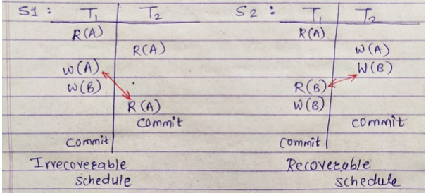
Example
Let us understand this with a simple example: Let’s say you are coping an examination paper from the person sitting in front of you. Then you should not submit/commit your paper until and unless the person in front of you submits first. Because he may later add some more points or change some answers which you will missout.
Example
In the above figure, S1 is not recoverable because T2 is committing before T1 although it is reading from T1. S2 is a recoverable schedule because T1 is committing after T2 as it has read from T2.

Slide 73
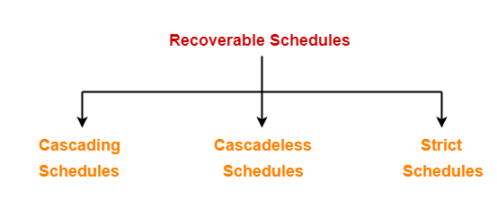
Types of Recoverable Schedule
A recoverable schedule may be any one of these kinds-

Slide 74
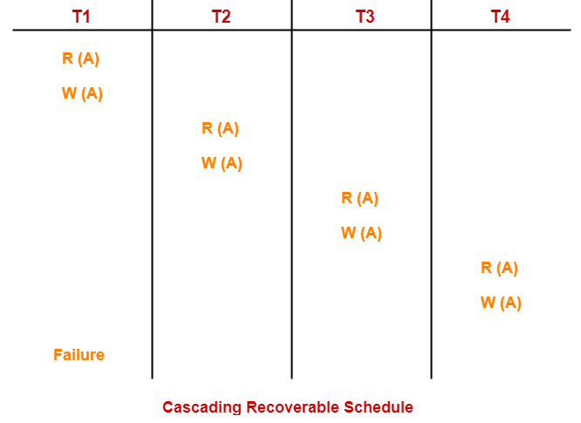
1. Cascading Schedule
Cascading Schedule-
If in a schedule, failure of one transaction causes several other dependent transactions to rollback or abort, then such a schedule is called as a Cascading Schedule or Cascading Rollback or Cascading Abort.
It simply leads to the wastage of CPU time.
Example-

Slide 75
Conti…..
Here,
Transaction T2 depends on transaction T1.
Transaction T3 depends on transaction T2.
Transaction T4 depends on transaction T3.
In this schedule,
The failure of transaction T1 causes the transaction T2 to rollback.
The rollback of transaction T2 causes the transaction T3 to rollback.
The rollback of transaction T3 causes the transaction T4 to rollback.
Such a rollback is called as a Cascading Rollback.
There arises a problem of cascading rollbacks, which is a rollback of a single transaction that will lead to a rollback of many other transactions, which will lead to less throughput and high time-consuming. Now comes the concept of cascadeless schedule/avoiding cascading abort.
NOTE-
If the transactions T2, T3 and T4 would have committed before the failure of transaction T1, then the schedule would have been irrecoverable.

Slide 76
2. Cascadeless Schedule
If in a schedule, a transaction is not allowed to read a data item until the last transaction that has written it is committed or aborted, then such a schedule is called as a Cascadeless Schedule.
In other words,
Cascadeless schedule allows only committed read operations.
Therefore, it avoids cascading roll back and thus saves CPU time.

Slide 77
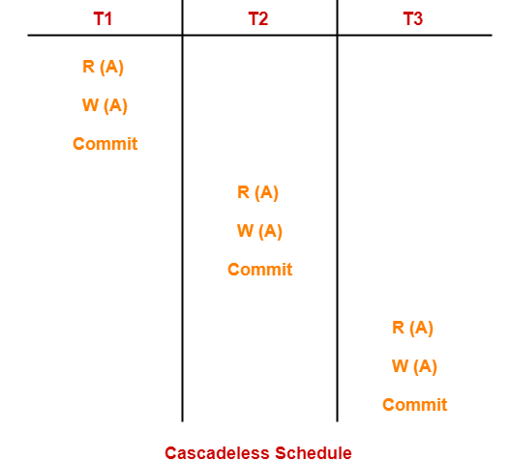
Example
Example
Here no uncommitted reads are allowed. That is no dirty reads are allowed. That is no W-R problem. Disallowing a transaction from reading uncommitted changes from another transaction. Cascadeless schedules are also recoverable.
In the above figure, the schedule is cascadeless because we are reading only after a committed write. But in a cascadeless schedule, there still can be a problem of W-W, or lost update problem.
So, to avoid that strict schedule comes into the picture.

Slide 78
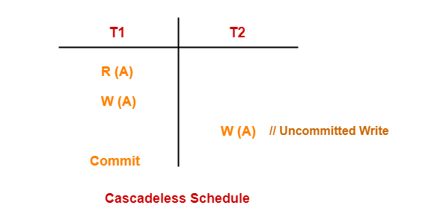
Continue
NOTE-
Cascadeless schedule allows only committed read operations.
However, it allows uncommitted write operations.
Example-

Slide 79
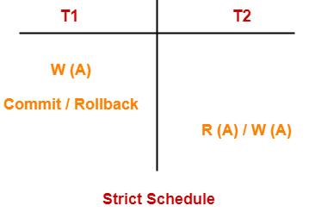
3. Strict Schedule
If in a schedule, a transaction is neither allowed to read nor write a data item until the last transaction that has written it is committed or aborted, then such a schedule is called as a Strict Schedule.
In a strict schedule if T1 performs W(A) then T2 is not allowed to R(A) or W(A) till T1 commits/rollback. Thus, avoiding the W-W(lost-update) problem and W-R problem. Strict schedules are cascadeless as well as recoverable.
In other words,
Strict schedule allows only committed read and write operations.
Clearly, strict schedule implements more restrictions than cascadeless schedule.
Example :-

Slide 80
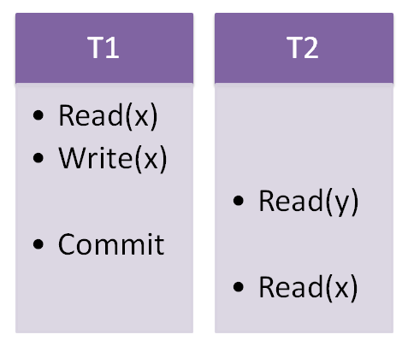
Example
In the above figure, this schedule is strict because T2 is doing R(X) only after committing T1. R(Y) is before commit but that is okay because it is on different data.
Remember-
Strict schedules are more strict than cascadeless schedules.
All strict schedules are cascadeless schedules.
All cascadeless schedules are not strict schedules.

Slide 81
In addition ,
serial schedule ⊆ strict schedule ⊆ cascadeless schedule ⊆ recoverable schedule

Slide 82
Failure Classification
1. Transaction failure :The transaction failure occurs when it fails to execute or when it reaches a point from where it can't go any further. If a few transaction or process is hurt, then this is called as transaction failure.
Reasons for a transaction failure could be –
Logical errors: transaction cannot complete due to some internal error condition
System errors: the database system must terminate an active transaction due to an error condition (e.g., deadlock).
2. System crash: a power failure or other hardware or software failure causes the system to crash.
Fail-stop assumption: non-volatile storage contents are assumed to not be corrupted by system crash
Database systems have numerous integrity checks to prevent corruption of disk data

Slide 83
Failure Classification
3. Disk failure: a head crash or similar disk failure destroys all or part of disk storage
-Disk failure occurs due to the formation of bad sectors, disk head crash, and unreachability to the disk or any other failure, which destroy all or part of disk storage.

Slide 84
Short Quiz
If a schedule S can be transformed into a schedule S’ by a series of swaps of non-conflicting instructions, then S and S’ are a) Non conflict equivalent b) Equal c) Conflict equivalent d) Isolation equivalent
A ___________of the transactions can be obtained by finding a linear order consistent with the partial order of the precedence graph. a) Serializability order b) Direction graph c) Precedence graph d) Scheduling scheme

Slide 85
Topic – Recovery Objective
Recovery Time Objective (RTO) is the duration of time and a service level within which a business process must be restored after a disaster in order to avoid unacceptable consequences associated with a break in continuity.
Transaction Recovery is an application recovery whereby the effects of specific transactions during a specified timeframe are removed from the database. ... User errors and application failures are the most common causes of problems requiring recovery, and therefore, the primary cause for system unavailability.

Slide 86
Recovery
The techniques used to recover the lost data due to system crash, transaction errors, viruses, catastrophic failure, incorrect commands execution etc. are database recovery techniques.
Example :-
Consider transaction T_{i} that transfers $50 from account A to account B
Two updates: subtract 50 from A and add 50 to B
Transaction T_{i} requires updates to A and B to be output to the database.
A failure may occur after one of these modifications have been made but before both of them are made.
Modifying the database without ensuring that the transaction will commit may leave the database in an inconsistent state.
Not modifying the database may result in lost updates if failure occurs just after transaction commits.

Slide 87
Data Access
Physical blocks are those blocks residing on the disk.
Buffer blocks are the blocks residing temporarily in main memory.
Block movements between disk and main memory are initiated through the following two operations:
input(B) transfers the physical block B to main memory.
output(B) transfers the buffer block B to the disk, and replaces the appropriate physical block there.
We assume, for simplicity, that each data item fits in, and is stored inside, a single block.

Slide 88
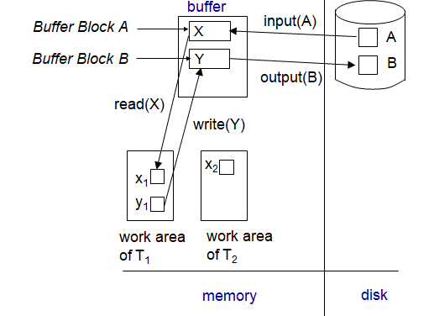
Example of Data Access

Slide 89
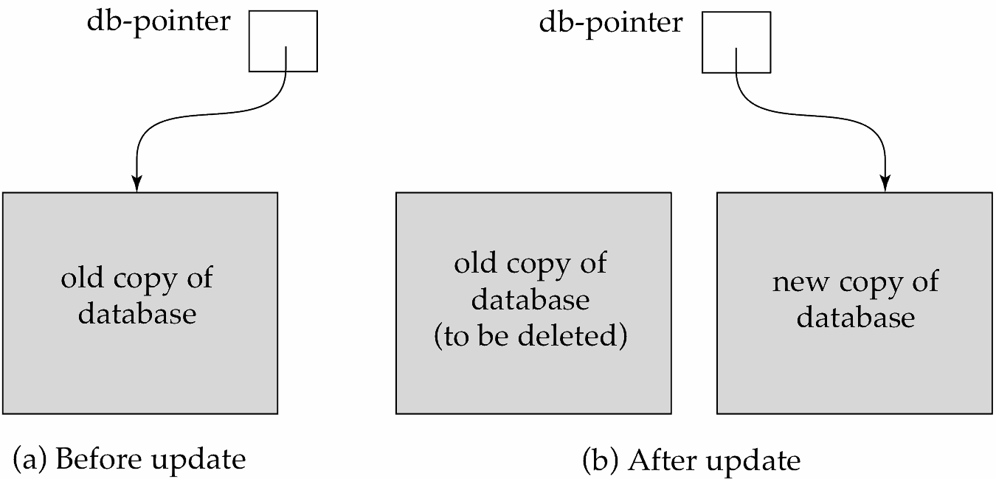
Recovery and Atomicity
To ensure atomicity despite failures, we first output information describing the modifications to stable storage without modifying the database itself.
Stable storage:
To implement stable storage, we need to replicate the needed information on several nonvolatile media with independent failure modes and to update the information in a controlled manner to ensure that failure during data transfer does not damage the needed information.
shadow-copy

Slide 90
Types of Recovery (CO4)
There are two method of Recovery
1. Log-Based Recovery
2. Shadow Paging

Slide 91
1. Log-Based Recovery
Recovery techniques are heavily dependent upon the existence of a special file known as a system log.
It contains information about the start and end of each transaction and any updates which occur in the transaction. The log keeps track of all transaction operations that affect the values of database items.
The log is a sequence of records. Log of each transaction is maintained in some stable storage so that if any failure occurs, then it can be recovered from there.
If any operation is performed on the database, then it will be recorded in the log.But the process of storing the logs should be done before the actual transaction is applied in the database.

Slide 92
Continue
Procedure :-
A log is kept on stable storage.
The log is a sequence of log records, and maintains a record of update activities on the database.
When transaction T_{i} starts, it registers itself by writing a <T_{i} start>log record
Before T_{i} executes write(X), a log record <T_{i}, X, V₁, V₂> is written, where V₁ is the value of X before the write (the old value), and V₂ is the value to be written to X (the new value).
When T_{i} finishes it last statement, the log record <T_{i} commit> is written.
Two approaches using logs
Immediate database modification
Deferred database modification

Slide 93
A. Immediate Database Modification
The Immediate modification technique occurs if database modification occurs while the transaction is still active.
In this technique, the database is modified immediately after every operation. It follows an actual database modification.
Example :-
Let's assume there is a transaction to modify the City of a student. The following logs are written for this transaction.
When the transaction is initiated, then it writes 'start' log.
<Tn, Start>
When the transaction modifies the City from 'Noida' to 'Bangalore', then another log is written to the file.
<Tn, City, 'Noida', 'Bangalore' >
When the transaction is finished, then it writes another log to indicate the end of the transaction.
<Tn, Commit>

Slide 94
B. Deferred Database Modification
The deferred modification technique occurs if the transaction does not modify the database until it has committed.
In this method, all the logs are created and stored in the stable storage, and the database is updated when a transaction commits.
Or
The deferred-modification scheme performs updates to buffer/disk only at the time of transaction commit
Simplifies some aspects of recovery
But has overhead of storing local copy

Slide 95
Short Quiz
State true or false: If I = read(Q) and J = read(Q) then the order of I and J does not matter. a) True b) False
State true or false: If I = read(Q) and J = write(Q) then the order of I and J does not matter. a) True b) False
A ___________of the transactions can be obtained by finding a linear order consistent with the partial order of the precedence graph. a) Serializability order b) Direction graph c) Precedence graph d) Scheduling scheme

Slide 96
Topic – Shadow Paging Objective
Shadow paging is one of the techniques that is used to recover from failure. We all know that recovery means to get back the information, which is lost. It helps to maintain database consistency in case of failure.
The general idea in shadow paging is that existing data is never overwritten, but instead modified pages are always written to new locations on disk, and a mapping is used to keep track of the current location of each page.

Slide 97
2. Shadow Paging
Shadow paging is an alternative to log-based recovery; this scheme is useful if transactions execute serially
Idea: maintain two page tables during the lifetime of a transaction –the current page table, and the shadow page table
Store the shadow page table in nonvolatile storage, such that state of the database prior to transaction execution may be recovered.
Shadow page table is never modified during execution
To start with, both the page tables are identical. Only current page table is used for data item accesses during execution of the transaction.
Whenever any page is about to be written for the first time
A copy of this page is made onto an unused page.
The current page table is then made to point to the copy
The update is performed on the copy

Slide 98
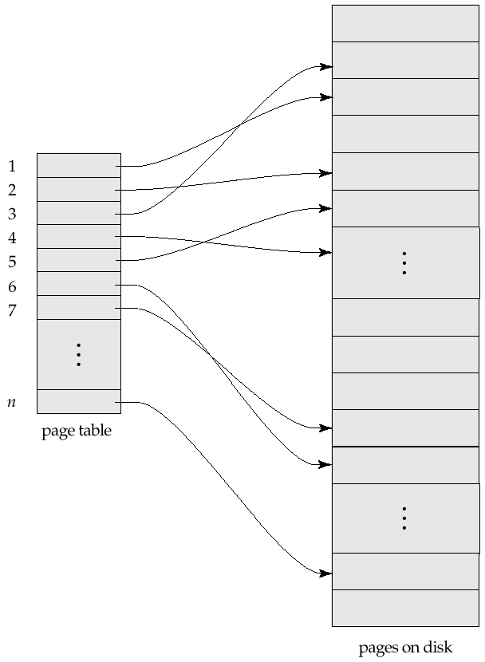
Sample Page Table

Slide 99
Shadow Paging advantage and Disadvantages
Advantages of shadow-paging over log-based schemes
no overhead of writing log records
recovery is trivial
Disadvantages :
Copying the entire page table is very expensive
Can be reduced by using a page table structured like a B⁺-tree
No need to copy entire tree, only need to copy paths in the tree that lead to updated leaf nodes
Commit overhead is high even with above extension
Need to flush every updated page, and page table
Data gets fragmented (related pages get separated on disk)
After every transaction completion, the database pages containing old versions of modified data need to be garbage collected
Hard to extend algorithm to allow transactions to run concurrently
Easier to extend log based schemes

Slide 100
Topic- Checkpoints Objective
Checkpoint is a mechanism where all the previous logs are removed from the system and stored permanently in a storage disk.
Checkpoint declares a point before which the DBMS was in consistent state, and all the transactions were committed.

Slide 101
Checkpoint
Problems in recovery procedure as discussed earlier :
1. searching the entire log is time-consuming
2. we might unnecessarily redo transactions which have already output their updates to the database.
The checkpoint is like a bookmark. While the execution of the transaction, such checkpoints are marked, and the transaction is executed then using the steps of the transaction, the log files will be created.
When it reaches to the checkpoint, then the transaction will be updated into the database, and till that point, the entire log file will be removed from the file. Then the log file is updated with the new step of transaction till next checkpoint and so on.
The checkpoint is used to declare a point before which the DBMS was in the consistent state, and all transactions were committed.

Slide 102
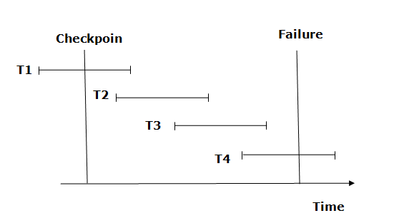
Recovery using Checkpoint
In the following manner, a recovery system recovers the database from this failure:-
Example :-

Slide 103
Why do we need Checkpoints ?
Whenever transaction logs are created in a real-time environment, it eats up lots of storage space. Also keeping track of every update and its maintenance may increase the physical space of the system.
Eventually, the transaction log file may not be handled as the size keeps growing. This can be addressed with checkpoints.
The methodology utilized for removing all previous transaction logs and storing them in permanent storage is called a Checkpoint.

Slide 104
Short Quiz
Which of the following scenarios may lead to an irrecoverable error in a database system ?
A. A transaction writes a data item after it is read by an uncommitted transaction
B. A transaction reads a data item after it is read by an uncommitted transaction
C. A transaction reads a data item after it is written by a committed transaction
D. A transaction reads a data item after it is written by an uncommitted transaction

Slide 105
Topics- Deadlock
In computer science, deadlock prevention algorithms are used in concurrent programming when multiple processes must acquire more than one shared resource.
A deadlock prevention algorithm organizes resource usage by each process to ensure that at least one process is always able to get all the resources it needs.

Slide 106
Deadlock
What is Deadlock?
A system is in a deadlock state if there exists a set of transactions such that every transaction in the set is waiting for another transaction in the set.
None of the transaction can make progress in such a situation. The only remedy to this undesirable condition is for system to invoke some drastic action, such as rolling back some of the transactions involved in the deadlock.
There are two methods for dealing with deadlock
1.Deadlock Prevention.
2.Deadlock detection & Recovery

Slide 107
Deadlock
What is Deadlock?
A system is in a deadlock state if there exists a set of transactions such that every transaction in the set is waiting for another transaction in the set.
None of the transaction can make progress in such a situation. The only remedy to this undesirable condition is for system to invoke some drastic action, such as rolling back some of the transactions involved in the deadlock.
There are four condition simultaneously hold for deadlock
Mutual Exclusion
Hold and wait
No Preemption
Circular wait

Slide 108
1. Deadlock Prevention
Deadlock Prevention:- This protocol ensure that the system is not goes deadlock state
There are two approaches to deadlock prevention.
One approach ensures that no cyclic waits can occur by ordering the requests for locks.
Second Approach is the rollback of transaction. The simplest scheme under the first approach requires that each transaction locks all its data before execution. Moreover, either all are locked or none.
Another Approach for preventing deadlocks is to impose an ordering of all data items, and to require that transaction lock data items in sequence.

Slide 109
Preemption-Prevention to Deadlock
The second approach for prevention of deadlock is preemption and transaction rollback.
In preemption, when a transaction T2 requests a lock that transaction T1 holds, the lock granted to T1 may be preempted by rolling back of T1 and granting of lock to T2.
Two different deadlock prevention Technique using Timestamps
1.Wait-Die Scheme
2.Wound-Wait Scheme

Slide 110
Preemption-Prevention to Deadlock
Wait-Die scheme
In this scheme, if a transaction requests for a resource which is already held with a conflicting lock by another transaction then the DBMS simply checks the timestamp of both transactions. It allows the older transaction to wait until the resource is available for execution.
Let's assume there are two transactions Ti and Tj and let TS(T) is a timestamp of any transaction T. If T2 holds a lock by some other transaction and T1 is requesting for resources held by T2 then the following actions are performed by DBMS:-
Check if TS(Ti) < TS(Tj) - If Ti is the older transaction and Tj has held some resource, then Ti is allowed to wait until the data-item is available for execution. That means if the older transaction is waiting for a resource which is locked by the younger transaction, then the older transaction is allowed to wait for resource until it is available.

Slide 111
Preemption-Prevention to Deadlock
B. Wound wait scheme
In wound wait scheme, if the older transaction requests for a resource which is held by the younger transaction, then older transaction forces younger one to kill the transaction and release the resource. After the minute delay, the younger transaction is restarted but with the same timestamp.
If the older transaction has held a resource which is requested by the Younger transaction, then the younger transaction is asked to wait until older releases it.
Lock Time Out

Slide 112
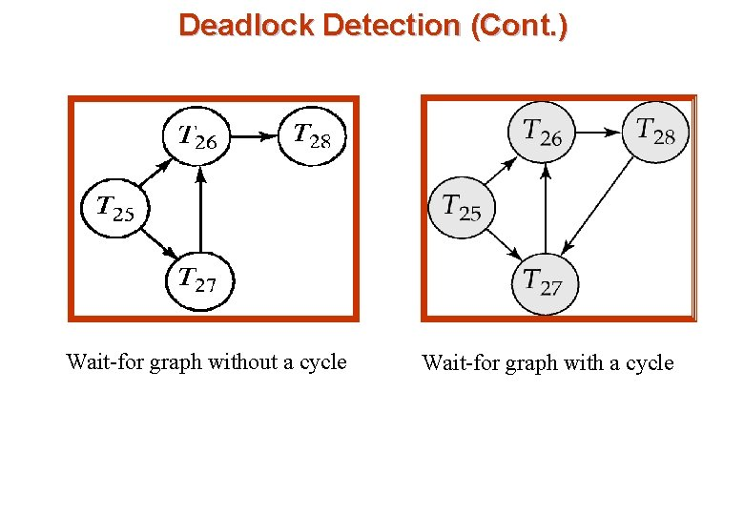
Deadlock Detection
Deadlocks can be described precisely in terms of a directed Graph called wait-for Graph.

Slide 113
Recovery From Deadlock
When a detection algorithm determines that a dead lock exist, the system must recover from the deadlock.
The most common solution is to rollback the transaction to break the deadlock. The following three actions should be taken: -
1.Selection Of Victim:- Given a set of deadlocked transactions, we should determine which transaction to rollback to break the deadlock. Following should be kept in mind for determining the roll back of transaction
a)How many data items the transaction has used?
b)How many more data items the transaction needs for it to complete?
c)How many transactions will be involved in rollback?

Slide 114
Conti…..
b)Rollback :- Once we have decided that a particular transaction must be rolled back, we must determine how far this transaction should be rolled back. The simplest solution is total roll back. Abort the transaction and restart it.
However it is efficient to roll back the transaction to break the deadlock. The deadlock detection mechanism should decide which locks the selected transaction needs to release in order to break the deadlock.
c)Starvation:- In a system where the selection of victims is based primarily on cost factors. It may happen that the same transaction is always picked as a victim.
As a result,the transaction never completes its designated task,thus there is a transaction. We must be ensure that a particular transaction is rolled back for finite times.

Slide 115
Remote Backup Systems
Remote backup systems provide high availability by allowing transaction processing to continue even if the primary site is destroyed.
Figure:- Remote Backup Systems

Slide 116
Remote Backup Systems (Cont.)
Detection of failure: Backup site must detect when primary site has failed
to distinguish primary site failure from link failure maintain several communication links between the primary and the remote backup.
Heart-beat messages
Transfer of control:
To take over control backup site first perform recovery using its copy of the database and all the long records it has received from the primary.
Thus, completed transactions are redone and incomplete transactions are rolled back.
When the backup site takes over processing it becomes the new primary
To transfer control back to old primary when it recovers, old primary must receive redo logs from the old backup and apply all updates locally.

Slide 117
Conti…..
Time to recover: To reduce delay in takeover, backup site periodically processes the redo log records (in effect, performing recovery from previous database state), performs a checkpoint, and can then delete earlier parts of the log.

Slide 118
Short Quiz
1. A system is in a ______ state if there exists a set of transactions such that every transaction in the set is waiting for another transaction in the set.
A. Idle
B. Waiting
C. Deadlock
D. Ready
The deadlock state can be changed back to stable state by using _____________ statement.
A. Commit
B. Rollback
C. Savepoint
D. Deadlock
What are the ways of dealing with deadlock ?
A. Deadlock prevention
B. Deadlock recovery
C. Deadlock detection
D. All of the mentioned

Slide 119
Concurrency Control (CO5)
A database must provide a mechanism that will ensure that all possible schedules are
either conflict or view serializable, and
are recoverable and preferably cascadeless
A policy in which only one transaction can execute at a time generates serial schedules, but provides a poor degree of concurrency
Are serial schedules recoverable/cascadeless?
Testing a schedule for serializability after it has executed is a little too late!
Goal – to develop concurrency control protocols that will assure serializability.

Slide 120
Concurrency Control Techniques (CO5)
Concurrency Control
it is process of managing simultaneous execution of transaction in a shared database to ensure the serializability of transaction.
Purpose of Concurrency Control
To enforce Isolation
To preserve database consistency
To resolve the read write or write – write conflicts.

Slide 121
Concurrency Control Techniques (CO5)
Concurrency Control Techniques
Time Stamping Protocol
Lock Based Protocol
2PL (2Phase Locking)
Graph Based Approach
Validation Based Protocol

Slide 122
Timestamp-Based Protocols
Each transaction is issued a timestamp when it enters the system. If an old transaction T_{i} has time-stamp TS(T_{i}), a new transaction T_{j} is assigned time-stamp TS(T_{j}) such that TS(T_{i}) <TS(T_{j}).
The protocol manages concurrent execution such that the time-stamps determine the serializability order.
In order to assure such behavior, the protocol maintains for each data Q two timestamp values:
W-timestamp(Q) is the largest time-stamp of any transaction that executed write(Q) successfully.
R-timestamp(Q) is the largest time-stamp of any transaction that executed read(Q) successfully.

Slide 123
Timestamp-Based Protocols (Cont.)
The timestamp ordering protocol ensures that any conflicting read and write operations are executed in timestamp order.
Suppose a transaction T_{i} issues a read(Q)
If TS(T_{i}) < W-timestamp(Q), then T_{i} needs to read a value of Q that was already overwritten.
Hence, the read operation is rejected, and T_{i} is rolled back.
If TS(T_{i}) ≥ W-timestamp(Q), then the read operation is executed, and R-timestamp(Q) is set to max(R-timestamp(Q), TS(T_{i})).

Slide 124
Timestamp-Based Protocols (Cont.)
Suppose that transaction T_{i} issues write(Q).
If TS(T_{i}) < R-timestamp(Q), then the value of Q that T_{i} is producing was needed previously, and the system assumed that that value would never be produced.
Hence, the write operation is rejected, and T_{i} is rolled back.
If TS(T_{i}) ≥ W-timestamp(Q), then T_{i} is attempting to write an obsolete value of Q.
Hence, this write operation is rejected, and T_{i} is rolled back.
Otherwise, the write operation is executed, and W-timestamp(Q) is set to TS(T_{i}).

Slide 125
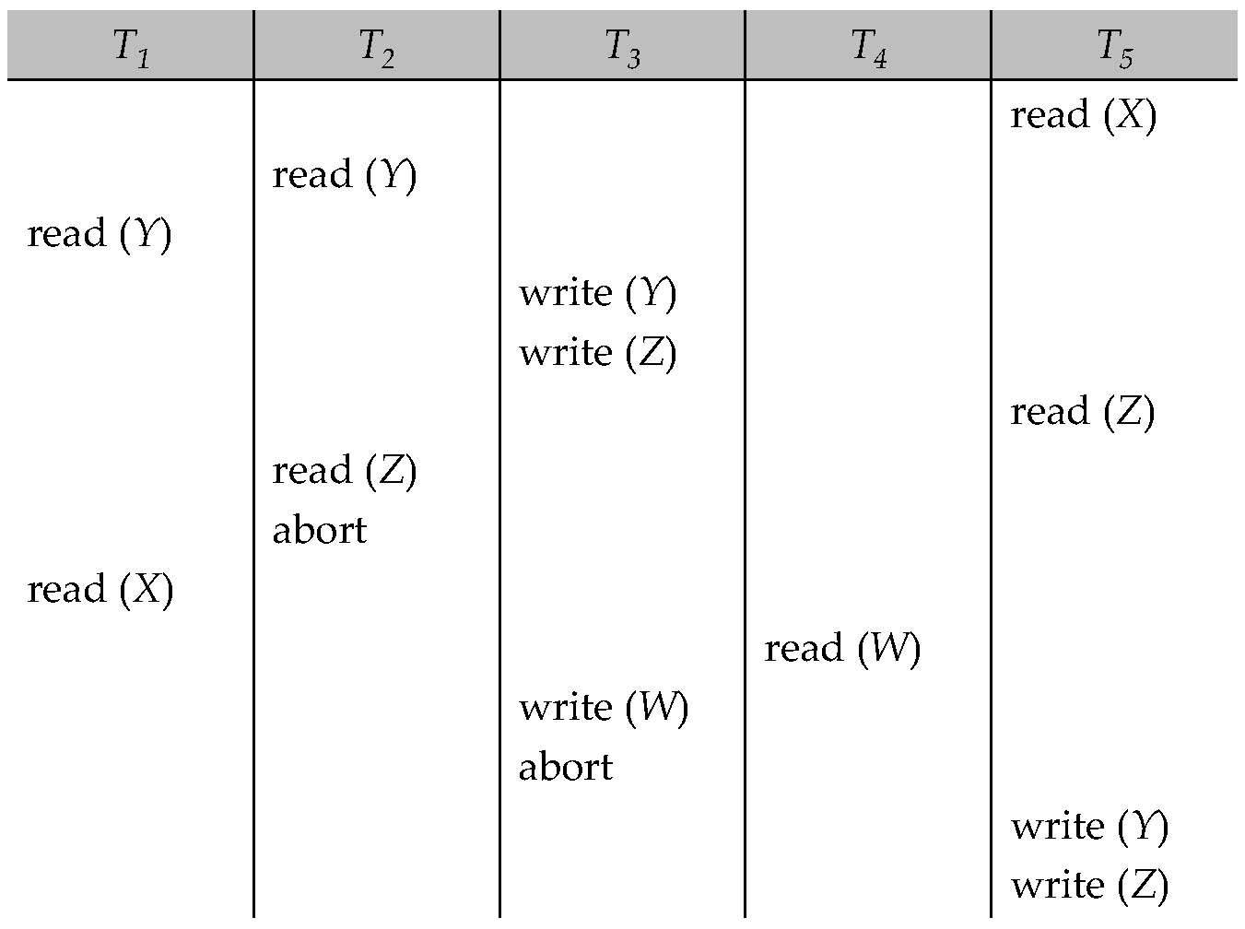
Timestamp-Based Protocols (Cont.)
A partial schedule for several data items for transactions with
timestamps 1, 2, 3, 4, 5

Slide 126
Thomas’ Write Rule
Modified version of the timestamp-ordering protocol in which obsolete write operations may be ignored under certain circumstances.
When T_{i} attempts to write data item Q, if TS(T_{i}) < W-timestamp(Q), then T_{i} is attempting to write an obsolete value of {Q}.
Rather than rolling back T_{i} as the timestamp ordering protocol would have done, this {write} operation can be ignored.
Otherwise this protocol is the same as the timestamp ordering protocol.
Thomas' Write Rule allows greater potential concurrency.
Allows some view-serializable schedules that are not conflict-serializable.

Slide 127
Lock-Based Protocols (CO5)
A lock is a mechanism to control concurrent access to a data item
To access data item lock is acquired
After completion of transaction lock must be released
Data items can be locked in two modes :
1. exclusive (X) mode. Data item can be both read as well as write. X-lock is requested using lock-X instruction.
2. shared (S) mode. Data item can only be read. S-lock is
requested using lock-S instruction.
Lock requests are made to concurrency-control manager. Transaction can proceed only after request is granted.

Slide 128
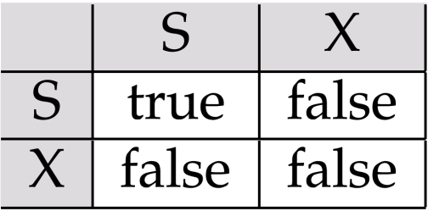
Lock-Based Protocols (CO5) contd
A locking protocol is a set of rules followed by all transactions while requesting and releasing locks. Locking protocols restrict the set of possible schedules.
Lock-compatibility matrix
A transaction may be granted a lock on an item if the requested lock is compatible with locks already held on the item by other transactions
Any number of transactions can hold shared locks on an item,
but if any transaction holds an exclusive on the item no other transaction may hold any lock on the item.
If a lock cannot be granted, the requesting transaction is made to wait till all incompatible locks held by other transactions have been released. The lock is then granted.

Slide 129
Lock-Based Protocols (CO5)
Example of a transaction performing locking:
T₂: lock-S(A);
read (A);
unlock(A);
lock-S(B);
read (B);
unlock(B);
display(A+B)
Locking as above is not sufficient to guarantee serializability
if A and B get updated in-between the read of A and B, the displayed sum would be wrong.

Slide 130
The Two-Phase Locking Protocol
This is a protocol which ensures conflict-serializable schedules.
Phase 1: Growing Phase
transaction may obtain locks
transaction may not release locks
Phase 2: Shrinking Phase
transaction may release locks
transaction may not obtain locks
The protocol assures serializability. It can be proved that the transactions can be serialized in the order of their lock points (i.e. the point where a transaction acquired its final lock).

Slide 131
The Two-Phase Locking Protocol (Cont.)
Two-phase locking does not ensure freedom from deadlocks
Cascading roll-back is possible under two-phase locking. To avoid this, follow a modified protocol called strict two-phase locking. Here a transaction must hold all its exclusive locks till it commits/aborts.
Rigorous two-phase locking is even stricter: here all locks are held till commit/abort. In this protocol transactions can be serialized in the order in which they commit.

Slide 132
The Two-Phase Locking Protocol (Cont.)
There can be conflict serializable schedules that cannot be obtained if two-phase locking is used.
However, in the absence of extra information (e.g., ordering of access to data), two-phase locking is needed for conflict serializability in the following sense:
Given a transaction T_{i} that does not follow two-phase locking, we can find a transaction T_{j} that uses two-phase locking, and a schedule for T_{i} and T_{j} that is not conflict serializable.

Slide 133
Lock Conversions (CO5)
Two-phase locking with lock conversions:
– First Phase:
can acquire a lock-S on item
can acquire a lock-X on item
can convert a lock-S to a lock-X (upgrade)
– Second Phase:
can release a lock-S
can release a lock-X
can convert a lock-X to a lock-S (downgrade)
This protocol assures serializability. But still relies on the programmer to insert the various locking instructions.

Slide 134
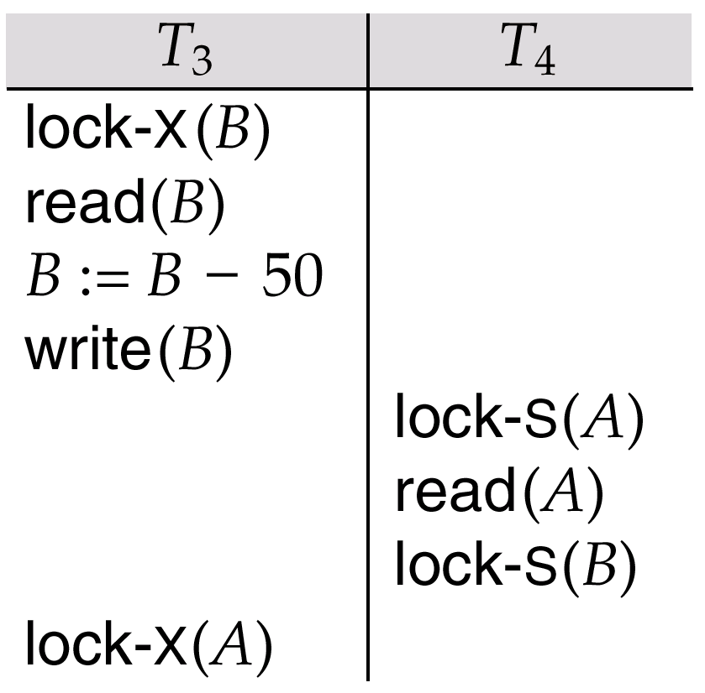
Pitfalls of Lock-Based Protocols
Consider the partial schedule
Neither T₃ nor T₄ can make progress — executing lock-S(B) causes T₄ to wait for T₃ to release its lock on B, while executing lock-X(A) causes T₃ to wait for T₄ to release its lock on A.
Such a situation is called a deadlock.
To handle a deadlock one of T₃ or T₄ must be rolled back and its locks released.

Slide 135
Pitfalls of Lock-Based Protocols
The potential for deadlock exists in most locking protocols. Deadlocks are a necessary evil.
Starvation is also possible if concurrency control manager is badly designed. For example:
A transaction may be waiting for an X-lock on an item, while a sequence of other transactions request and are granted an S-lock on the same item.
The same transaction is repeatedly rolled back due to deadlocks.
Concurrency control manager can be designed to prevent starvation.

Slide 136
The Two-Phase Locking Protocol (Cont.)
Problems with 2-PL,
Cascading Aborts and Deadlocks.
There are three categories:
Strict 2-PL
Rigorous 2-PL
Conservative 2-PL

Slide 137
The Two-Phase Locking Protocol (Cont.)
Conservative 2-PL –
Static 2-PL, this protocol requires the transaction to lock all the items it access before the Transaction begins execution by predeclaring its read-set and write-set.
If any of the predeclared items needed cannot be locked, the transaction does not lock any of the items, instead it waits until all the items are available for locking. Conservative 2-PL is Deadlock free and but it does not ensure Strict schedule

Slide 138
The Two-Phase Locking Protocol (Cont.)
Strict-2PL
The first phase of Strict-2PL is same as 2PL.
After acquiring all the locks in the first phase, the transaction continues to execute normally. But in contrast to 2PL, Strict-2PL does not release a lock after using it.
Strict-2PL holds all the locks until the commit point and releases all the locks at a time.
Strict-2PL does not have cascading abort as 2PL does.
Following Strict 2-PL ensures that our schedule is:
Recoverable
Cascadeless

Slide 139
The Two-Phase Locking Protocol (Cont.)
Rigorous 2-PL –
This requires that in addition to the lock being 2-Phase all Exclusive(X) and Shared(S) Locks held by the transaction be released until after the Transaction Commits.
Following Rigorous 2-PL ensures that our schedule is:
Recoverable
Cascadeless

Slide 140
Graph based protocol
A lock based technique that guarantees serializability that is not based on 2PL.
Additional information is required, how the transactions will use the data.
We need an idea about the order the data items are to be accessed.
Partial ordering is imposed on the data items.
Only Exclusive Locks are allowed.
The first lock by Ti may be on any data item.
Subsequently, a data Q can be locked by Ti only if the parent of Q is currently locked by Ti.
Data items can be unlocked at any time.
Data item locked and unlocked by a transaction Ti can not be subsequently relocked by the same transaction.

Slide 141
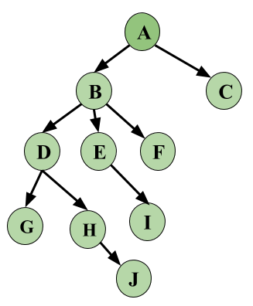
Graph based protocol

Slide 142
Validation based protocol
Validation Based Protocol is also called Optimistic Concurrency Control Technique. This protocol is used in DBMS (Database Management System) for avoiding concurrency in transactions. It is called optimistic because of the assumption it makes, i.e. very less interference occurs, therefore, there is no need for checking while the transaction is executed.
In this technique, no checking is done while the transaction is been executed. Until the transaction end is reached updates in the transaction are not applied directly to the database. All updates are applied to local copies of data items kept for the transaction. At the end of transaction execution, while execution of the transaction, a validation phase checks whether any of transaction updates violate serializability. If there is no violation of serializability the transaction is committed and the database is updated; or else, the transaction is updated and then restarted.

Slide 143
Validation based protocol
Optimistic Concurrency Control is a three-phase protocol. The three phases for validation based protocol:
Read Phase:
Values of committed data items from the database can be read by a transaction. Updates are only applied to local data versions.
Validation Phase:
Checking is performed to make sure that there is no violation of serializability when the transaction updates are applied to the database.
Write Phase:
On the success of the validation phase, the transaction updates are applied to the database, otherwise, the updates are discarded and the transaction is slowed down.

Slide 144
Multiple Granularity Locking Scheme (CO 5)
Transaction T_{i} can lock a node Q, using the following rules:
The lock compatibility matrix must be observed.
The root of the tree must be locked first, and may be locked in any mode.
A node Q can be locked by T_{i} in S or IS mode only if the parent of Q is currently locked by T_{i} in either IX or IS mode.
A node Q can be locked by T_{i} in X, SIX, or IX mode only if the parent of Q is currently locked by T_{i} in either IX or SIX mode.
T_{i} can lock a node only if it has not previously unlocked any node (that is, T_{i} is two-phase).
T_{i} can unlock a node Q only if none of the children of Q are currently locked by T_{i}.
Observe that locks are acquired in root-to-leaf order, whereas they are released in leaf-to-root order.

Slide 145
Multiple Granularity (CO4)
Allow data items to be of various sizes and define a hierarchy of data granularities, where the small granularities are nested within larger ones.
Can be represented graphically as a tree.
When a transaction locks a node in the tree explicitly, it implicitly locks all the node's descendents in the same mode.
Granularity of locking (level in tree where locking is done):
fine granularity (lower in tree): high concurrency, high locking overhead
coarse granularity (higher in tree): low locking overhead, low concurrency
Reference Book :- DATABASE SYSTEM Concepts (6th Edition) Abraham Silberschatz, Henry F. Korth, S. Sudarshan. Page No. -679-682.
For video link:- http://www.infocobuild.com/education/audio-video-courses/computer-science/FundamentalsOfDatabaseSystems-IIT-Kanpur/lecture-42.html
https://www.youtube.com/watch?v=jm1NUBMpyVo

Slide 146
Example of Granularity Hierarchy
The levels, starting from the (top) level are
database
area
file
record
Figure :- Granularity hierarchy

Slide 147
Intention Lock Modes
In addition to S and X lock modes, there are three additional lock modes with multiple granularity:
intention-shared (IS): indicates explicit locking at a lower level of the tree but only with shared locks.
intention-exclusive (IX): indicates explicit locking at a lower level with exclusive or shared locks
shared and intention-exclusive (SIX): the subtree rooted by that node is locked explicitly in shared mode and explicit locking is being done at a lower level with exclusive-mode locks.
intention locks allow a higher level node to be locked in S or X mode without having to check all descendent nodes.
For video lecture:- https://www.youtube.com/watch?v=yIqBwxokm40&list=PLyvBGMFYV3auVdxQ1-88ivNFpmUEy-U3M&index=35

Slide 148
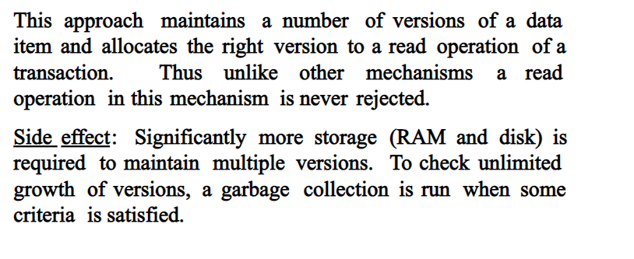
Multi version Concurrency Control Technique (CO 5)

Slide 149
Multi version Concurrency Control Technique (CO 5)
Multiversion schemes keep old versions of data item to increase concurrency.
Multiversion Timestamp Ordering
Multiversion Two-Phase Locking
Snapshot isolation
Each successful write results in the creation of a new version of the data item written.
Use timestamps to label versions.
When a read(Q) operation is issued, select an appropriate version of Q based on the timestamp of the transaction, and return the value of the selected version.
reads never have to wait as an appropriate version is returned immediately.

Slide 150
Multi version Concurrency Control Technique (CO 5)
MVCC: Implementation Issues
Creation of multiple versions increases storage overhead
Extra tuples
Extra space in each tuple for storing version information
Versions can, however, be garbage collected
E.g. if Q has two versions Q5 and Q9, and the oldest active transaction has timestamp > 9, than Q5 will never be required again

Slide 151
Multi version Concurrency Control Technique (CO 5)
MVCC: Implementation Issues
Creation of multiple versions increases storage overhead
Extra tuples
Extra space in each tuple for storing version information
Versions can, however, be garbage collected
E.g. if Q has two versions Q5 and Q9, and the oldest active transaction has timestamp > 9, than Q5 will never be required again

Slide 152
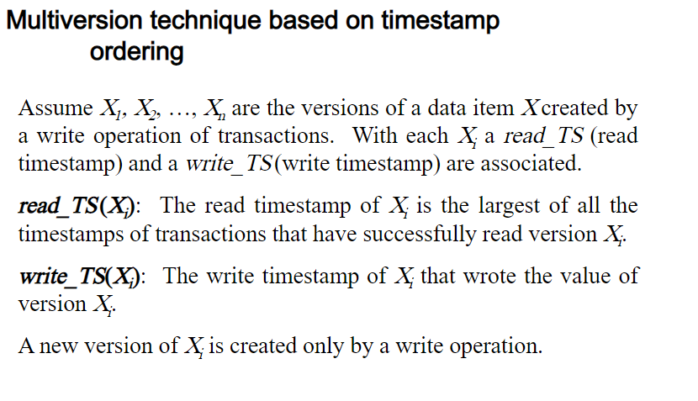
Multi version Concurrency Control Technique (CO 5)

Slide 153
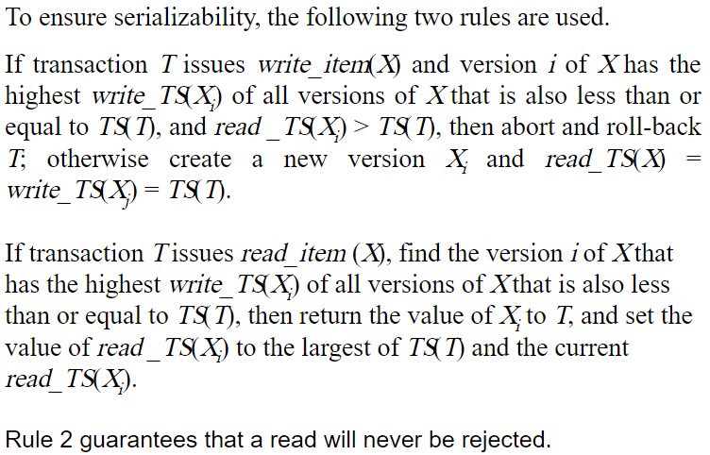
Multi version Concurrency Control Scheme (CO 5)

Slide 154
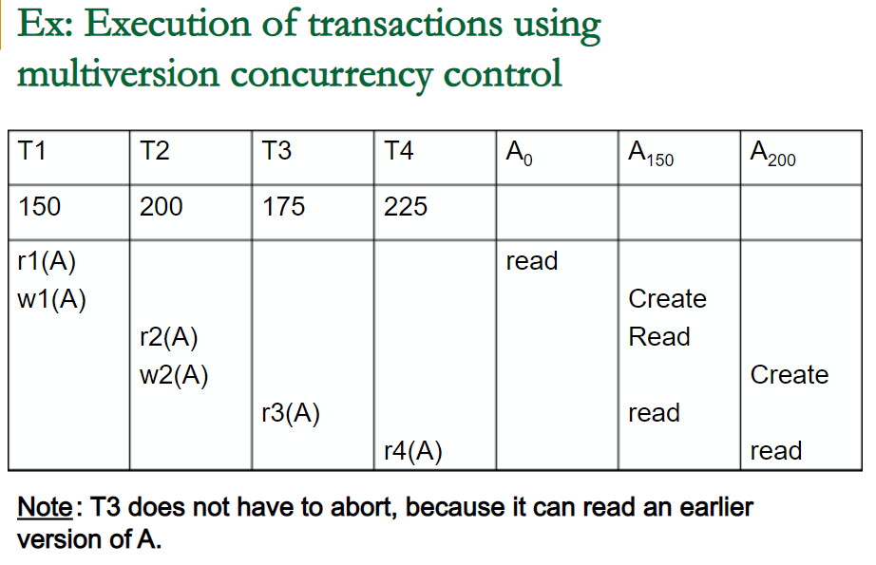
Multi version Concurrency Control Scheme (CO 5)

Slide 155
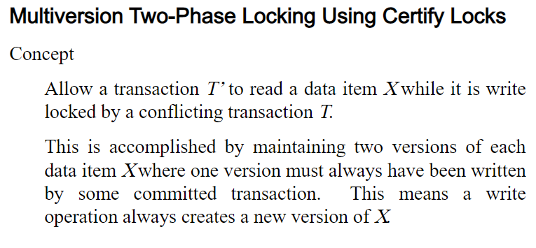
Multi version Concurrency Control Scheme (CO 5)

Slide 156
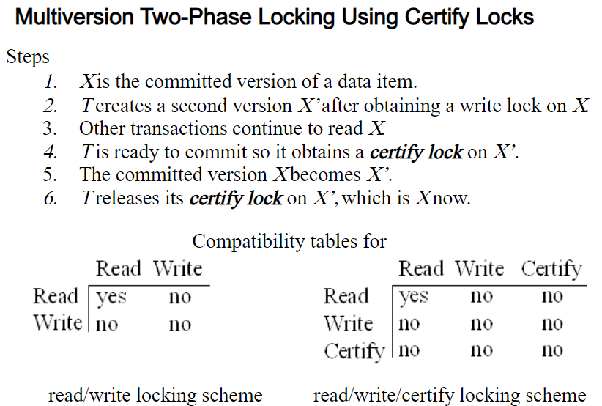
Multi version Concurrency Control Scheme (CO 5)

Slide 157
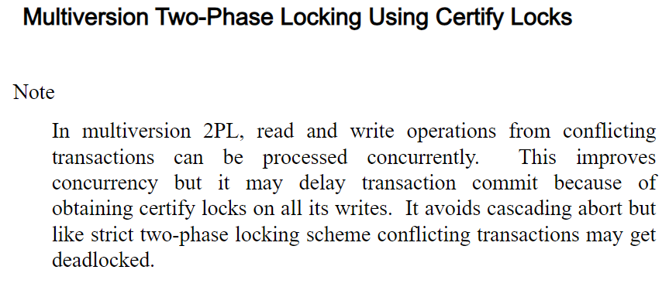
Multi version Concurrency Control Scheme (CO 5)

Slide 158
Topic-Distributed Database Objective
The basic function of DDBMS is basically to decide which copy of a replicated data item to access and to maintain the consistency of copies of replicated data items.
The ability to recover from the individual site crashes and from new types of failures such as failure of communication links.
The main objectives of query processing in a distributed environment is to form a high level query on a distributed database, which is seen as a single database by the users, into an efficient execution strategy expressed in a low level language in local databases.

Slide 159
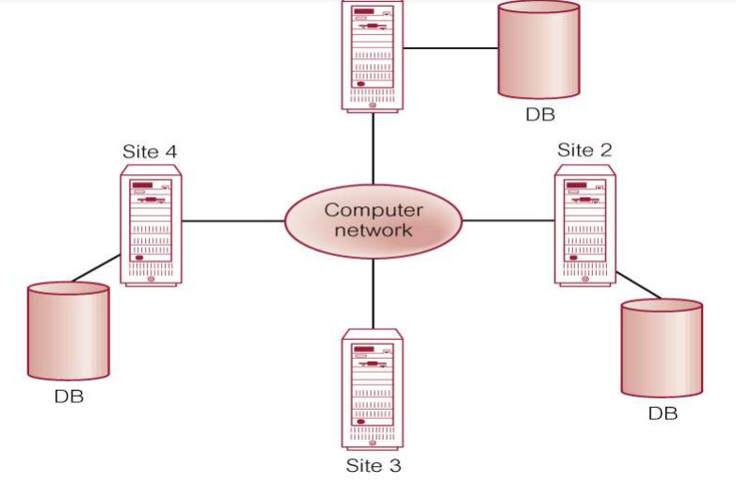
What is Distributed Database?
A distributed database (DDB) is a collection of multiple, logically interrelated databases distributed over a computer network.
A distributed database management system (DDBMS) is the software that manages the DDB and provides an access mechanism that makes this distribution transparent to the users.
Distributed database (DDB)

Slide 160
Types of Distributed Database
A DDBMS mainly classified into two types: -
1. Homogeneous Distributed database management systems:-
In a homogeneous distributed database all sites have identical software and are aware of each other and agree to cooperate in processing user requests. The homogeneous system is much easier to design and manage The operating system used, at each location must be same or compatible. The database application (or DBMS) used at each location must be same or compatible.
2. Heterogeneous Distributed database management systems:-
In a heterogeneous distributed database different sites may use different schema and software. In heterogeneous systems, different nodes may have different hardware & software and data structures at various nodes or locations are also incompatible. Different computers and operating systems, database applications or data models may be used at each of the locations.

Slide 161
Conti…..
Characteristics Distributed database (DDB) are
All sites are interconnected.
Fragments can be replicated.
Logically related shared data can be collected.
Data at each and every site is controlled by the DBMS.
Each Distributed Database Management System takes part in at least one global application.
Functionality Distributed database (DDB) are
Security
Keeping track of data
Replicated data management
System catalog management
Distributed transaction management
Distributed database recovery

Slide 162
Advantages & Disadvantages
Advantages of Distributed database (DDB) are :-
Less danger of a single-point failure. When one of the computers fails, the workload is picked up by other workstations.
Data are also distributed at multiple sites.
The end user is able to access any available copy of the data, and an end user's request is processed by any processor at the data location.
Improved communications. Because local sites are smaller and located closer to customers.
Reduced operating costs. It is more cost effective to add workstations to a network than to update a mainframe system.
Faster data access, faster data processing.
A distributed database system spreads out the systems workload by processing data at several sites.

Slide 163
Cont….
Disadvantages Distributed database (DDB) are
Complexity of management and control.
Applications must recognize data location, and they must be able to stitch together data from various sites.
Security.
Increased storage and infrastructure requirements.
Multiple copies of data has to be at different sites, thus an additional disk storage space will be required.
The probability of security lapses increases when data are located at multiple sites

Slide 164
System Failure Modes
Failures unique to distributed systems:
Failure of a site.
Loss of messages
Handled by network transmission control protocols such as TCP-IP
Failure of a communication link
Handled by network protocols, by routing messages via alternative links
Network partition
A network is said to be partitioned when it has been split into two or more subsystems that lack any connection between them
Note: a subsystem may consist of a single node
Network partitioning and site failures are generally indistinguishable.

Slide 165
Commit Protocols
Commit protocols are used to ensure atomicity across sites
a transaction which executes at multiple sites must either be committed at all the sites, or aborted at all the sites.
not acceptable to have a transaction committed at one site and aborted at another
The two-phase commit (2PC) protocol is widely used
The three-phase commit (3PC) protocol is more complicated and more expensive, but avoids some drawbacks of two-phase commit protocol. This protocol is not used in practice.

Slide 166
Two Phase Commit Protocol (2PC)
Assumes fail-stop model – failed sites simply stop working, and do not cause any other harm, such as sending incorrect messages to other sites.
Execution of the protocol is initiated by the coordinator after the last step of the transaction has been reached.
The protocol involves all the local sites at which the transaction executed
Let T be a transaction initiated at site S_{i}, and let the transaction coordinator at S_{i} be C_{i}

Slide 167
Phase 1: Obtaining a Decision (Voting Phase)
Coordinator asks all participants to prepare to commit transaction T_{i}.
C_{i} adds the records <prepare T> to the log and forces log to stable storage
sends prepare T messages to all sites at which T executed
Upon receiving message, transaction manager at site determines if it can commit the transaction
if not, add a record <no T> to the log and send abort T message to C_{i}
if the transaction can be committed, then:
add the record <ready T> to the log
force all records for T to stable storage
send ready T message to C_{i}

Slide 168
Phase 2: Recording the Decision
T can be committed of C_{i} received a ready T message from all the participating sites: otherwise T must be aborted.
Coordinator adds a decision record, <commit T> or <abort T>, to the log and forces record onto stable storage. Once the record stable storage it is irrevocable (even if failures occur)
Coordinator sends a message to each participant informing it of the decision (commit or abort)
Participants take appropriate action locally.

Slide 169
Handling of Failures - Site Failure
When site S_{i} recovers, it examines its log to determine the fate of
transactions active at the time of the failure.
Log contain <commit T> record: txn had completed, nothing to be done
Log contains <abort T> record: txn had completed, nothing to be done
Log contains <ready T> record: site must consult C_{i} to determine the fate of T.
If T committed, redo (T); write <commit T> record
If T aborted, undo (T)
The log contains no log records concerning T:
Implies that S_{k} failed before responding to the prepare T message from C_{i}
since the failure of S_{k} precludes the sending of such a response, coordinator C₁ must abort T
S_{k} must execute undo (T)

Slide 170
Handling of Failures- Coordinator Failure
If coordinator fails while the commit protocol for T is executing then participating sites must decide on T’s fate:
If an active site contains a <commit T> record in its log, then T must be committed.
If an active site contains an <abort T> record in its log, then T must be aborted.
If some active participating site does not contain a <ready T> record in its log, then the failed coordinator C_{i} cannot have decided to commit T.
Can therefore abort T; however, such a site must reject any subsequent <prepare T> message from C_{i}
If none of the above cases holds, then all active sites must have a <ready T> record in their logs, but no additional control records (such as <abort T> of <commit T>).
In this case active sites must wait for C_{i} to recover, to find decision.
Blocking problem: active sites may have to wait for failed coordinator to recover.

Slide 171
Handling of Failures - Network Partition
If the coordinator and all its participants remain in one partition, the failure has no effect on the commit protocol.
If the coordinator and its participants belong to several partitions:
Sites that are not in the partition containing the coordinator think the coordinator has failed, and execute the protocol to deal with failure of the coordinator.
No harm results, but sites may still have to wait for decision from coordinator.
The coordinator and the sites are in the same partition as the coordinator think that the sites in the other partition have failed, and follow the usual commit protocol.
Again, no harm results

Slide 172
Daily Quiz
What is serializability?
What are the types of serializable schedules?
Define recoverability.
What do you understand by log based recovery?
Explain concurrency control.
What do you mean by directory system.
What is distributed data storage?
How do you test serializability?

Slide 173
Weekly Assignment
Explain ACID properties to preserve the integrity of database. CO4
Differentiate between conflict and view serializable schedule. CO4
What do you mean by transaction processing? CO4
What do you understand by distributed databases? Give the various advantages and disadvantages of distributed database management system. CO4
What is a deadlock? How can a deadlock occur? Explain. CO4
What is Log? How is it maintained? CO4
Discuss the salient features of deferred database modification and immediate database modification strategies in brief CO4

Slide 174
Faculty Video Links, Youtube & NPTEL Video Links and Online Courses Details
Self Made Video Link:
Youtube/other Video Links
https://www.youtube.com/watch?v=5ammL5KU4mo
https://www.youtube.com/watch?v=HAAhn--tZV8
https://www.youtube.com/watch?v=q6ISl9YNxoQ
https://www.youtube.com/watch?v=XCLA0cjk0o8&t=17s
https://www.youtube.com/watch?v=Yu4rIeQZOjo
https://www.youtube.com/watch?v=HhLhIEnsBR0
https://www.youtube.com/watch?v=u3-ciC_TC_k
https://www.youtube.com/watch?v=qH2iYtuJEwQ&t=330s
https://www.youtube.com/watch?v=Jw3jDTAXuAk&list=PL-zLo58JCM3BkfC_wlAosP5VTLV9ObiW1&index=37
https://www.youtube.com/watch?v=IYaxn0qkzUI&t=12s
https://www.youtube.com/watch?v=xCxdBkFX_ww
https://www.youtube.com/watch?v=-r734q6sSa0

Slide 175
MCQ s
In which state, the transaction will wait for the final statement has been executed?
a) Active
b) Failed
c) Aborted
d) partially committed
A Transaction ends
a) only when it is Committed.
b) only when it is Rolled-back
c) when it is Committed or Rolled-back
d) only when it is initialized

Slide 176
MCQ s
Identify the characteristics of transactions a) Atomicity b) Durability c) Isolation d) All of the mentioned
Consider money is transferred from (1)account-A to account-B and (2) account-B to account-A. Which of the following form a transaction? a) Only 1 b) Only 2 c) Both 1 and 2 individually d) Either 1 or 2

Slide 177
MCQ s
A distributed database has which of the following advantages over a centralized database?
a) Software cost
b) Software complexity
c) Slow Response
d) Modular growth

Slide 178
Glossary Questions
1. What are advantages and disadvantages of Distributed DBMS.
2. What are the features of DDBMS?
3. Explain the basic Timestamp Ordering Algorithm.
4. What are the objectives of Distributed Query Processing?
5. What is horizontal and vertical fragmentation? What are the types of horizontal fragmentation. Perform horizontal Fragmentation for student relation as given below. Also give the corrextness criteria for it. Students (studentrollno., Student Name, Course Name, Course Name, Course fees, year)
6. What are the various kinds of transparencies in distributed database design? Explain each with the help of example.

Slide 179
Old Question Papers
http://www.aktuonline.com/papers/btech-cs-5-sem-data-base-management-system-KCS501-2020.pdf
http://www.aktuonline.com/papers/btech-cs-5-sem-database-management-system-KCS-501-2018-19.pdf
http://www.aktuonline.com/papers/btech-cs-5-sem-database-management-system-ncs-502-2017-18.pdf
http://www.aktuonline.com/papers/btech-cs-5-sem-database-management-system-ncs-502-2016-17.pdf

Slide 180
Expected Questions for University Exam
What do you mean by Conflict Serializable Schedule?
What are Distributed Database? List advantage and disadvantage of data Replication And data Fragmentation.
What do you understand by ACID properties of transaction ? Explain in details.
Discuss about deadlock prevention schemes.
Define Transaction and explain its properties with suitable example.
What is schedule? What are its types? Explain view serializable and cascadeless schedule with suitable example of each.
Which of the following schedules are conflicts serializable? For each serializable schedule find the equivalent schedule. S1: r1(x); r3(x); w3(x); w1(x); r2(x) S2: r3(x); r2(x); w3(x); r1(x); w1(x) S3: r1(x); r2(x); r3(y); w1(x); r2(z); r2(y); w2(y)

Slide 181
Recap of Unit
Knowledge of transaction processing concept.
Knowledge of how to recover from transaction failures.
Knowledge of distributed database.

Slide 182
Thank You

